Slide 1

UX document for
Sony Digital Marketing Campaign tracker
Highway Timeline wireframe
Jun 6, 2014

Slide 2














Campaign
Australia
Timeline
Calendar
------------------------------------------------ February
------------------------------------------------ January
----------------------------------------------------------------------- De
Title
poster
Title
poster
Title
poster
Title
poster
Title
poster

Slide 3
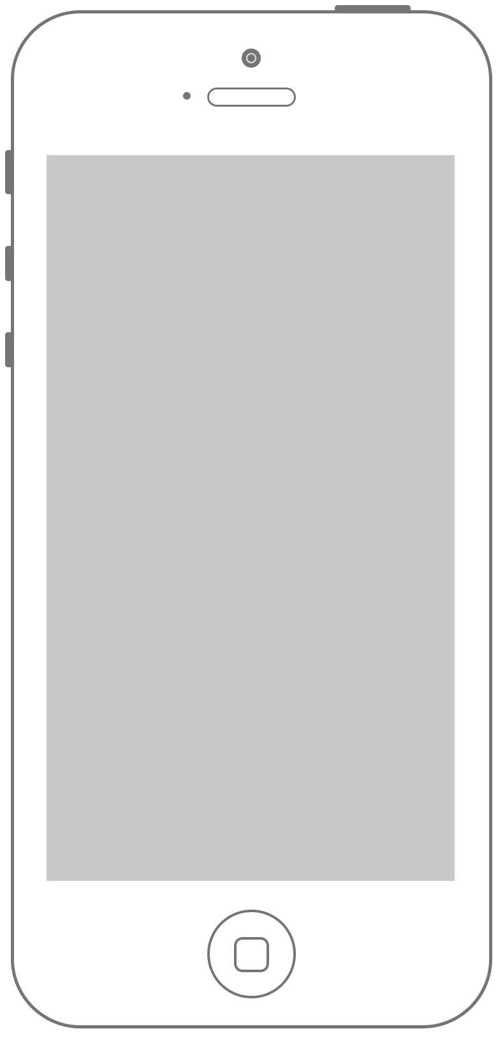

Campaign
Australia
Timeline
Calendar
----------------------- February
----------------------- January
---------------------------------- Dece
Title
poster
Title
poster
Title
poster

Slide 4
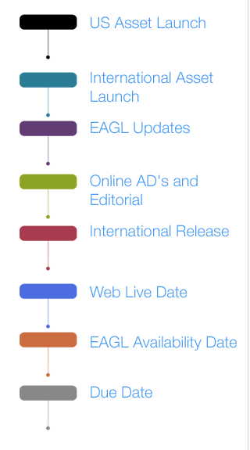
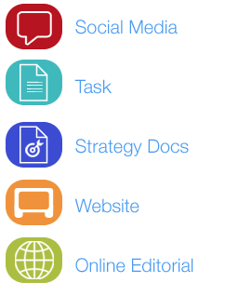
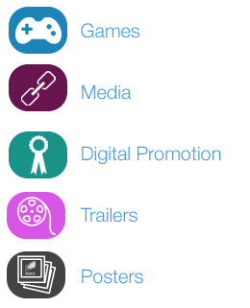
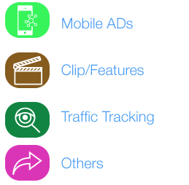
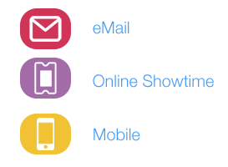
Conditions- High level timeline
1. The timeline will show
Either a 11 week plan (for titles for whose campaign have not started)
Or
the Asset pegs with 1.International release 2.US asset launch & 3.

Slide 5

Thank you

